Slide 1
Factors Associated with Response Time of Emergency Medical Service(EMS) in New York City
Youn Kyeong Chang (yc3242), Pengxuan Chen(pc2853), Anusorn Thanataveerat (at2710), Apoorva Srinivasan (as5697), Abhishek Ajay (aa4266)

Slide 2
Questions that drove our analysis:
* How is the response time affected by the weather specifically when it is snowing or raining or by seasons?
* How often does the EMS arrive within ideal time(8mins)?
* How is different during different times of the day?
* What is the relationship in emergency response time between a economically well off area - Upper West Side and a relatively poorer area such as Washington Heigths?

Slide 3
Data sources and preparation
Incidents Responded to by Fire Companies: [https://data.cityofnewyork.us/Public-Safety/Incidents-Responded-to-by-Fire-Companies/tm6d-hbzd]
The New York City Weather Data [https://www.ncdc.noaa.gov/cdo-web/datasets]
Street Closure due to Construction data : [https://data.cityofnewyork.us/Transportation/Street-Closures-due-to-construction-activities-by-/478a-yykk]
Notes:
Data preparation: we merged the first two dataset into one “finaldat”, and filtered it with two neighborhood and merged with the third dataset to create a “subset” data.

Slide 4
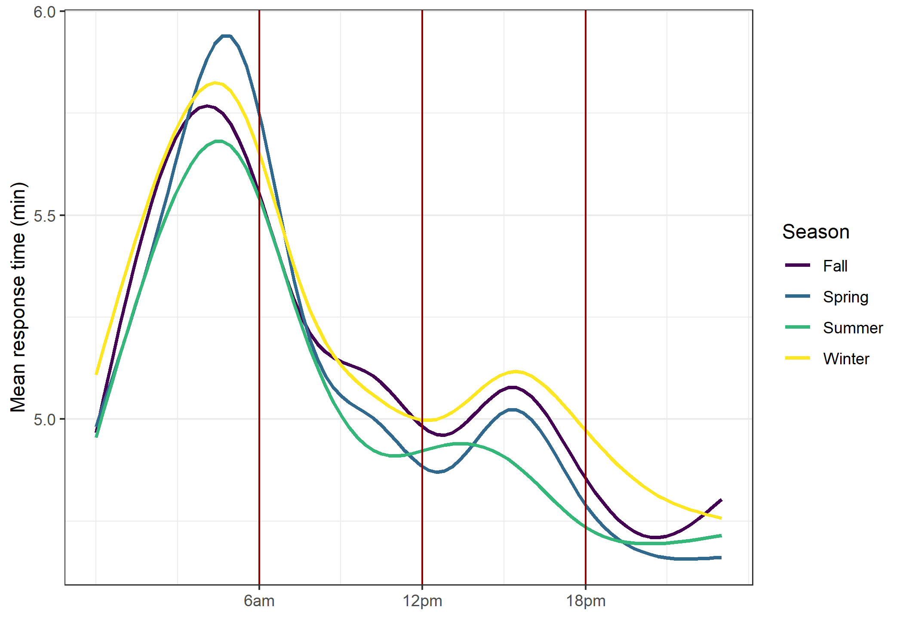

Slide 5
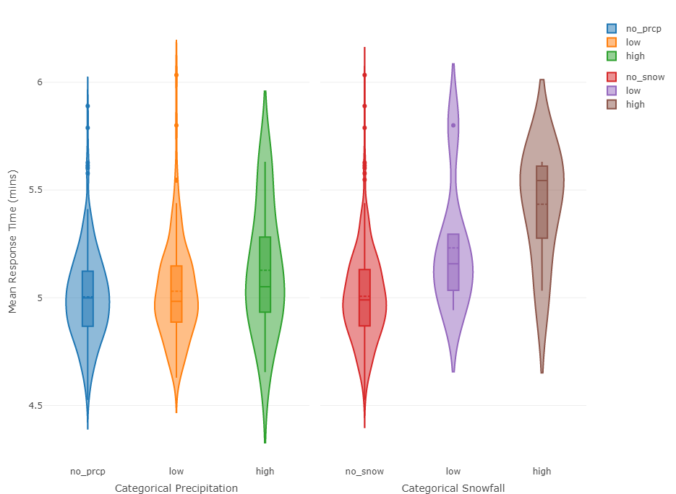

Slide 6
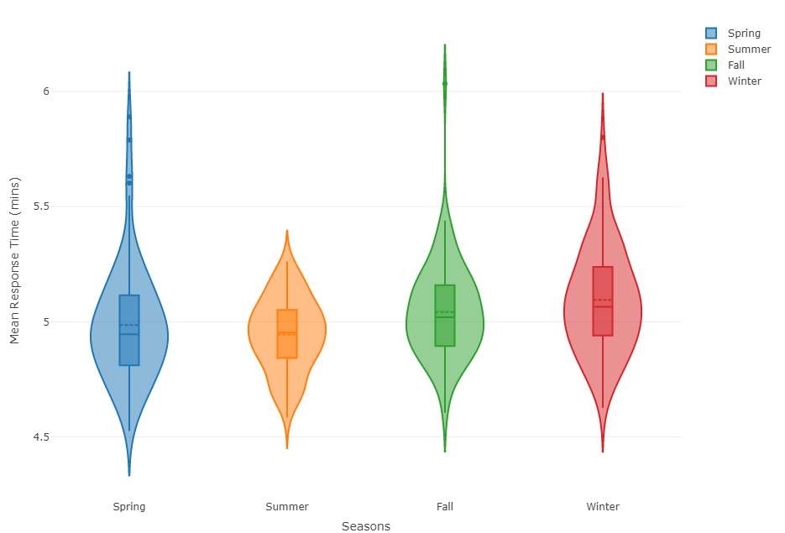

Slide 7
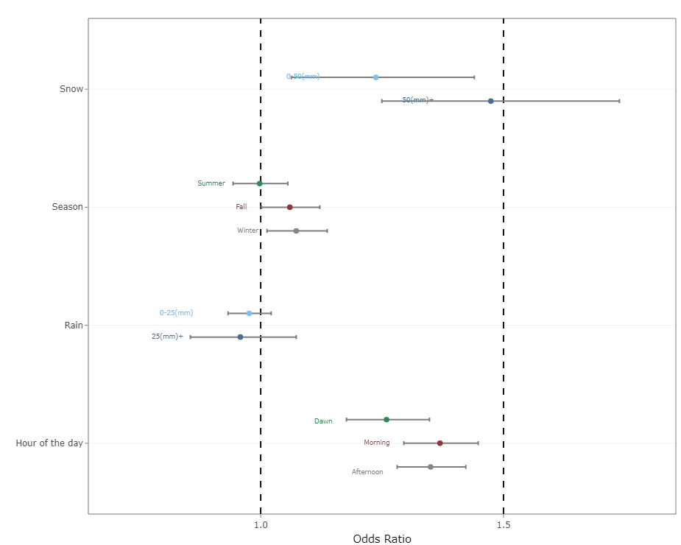

Slide 8
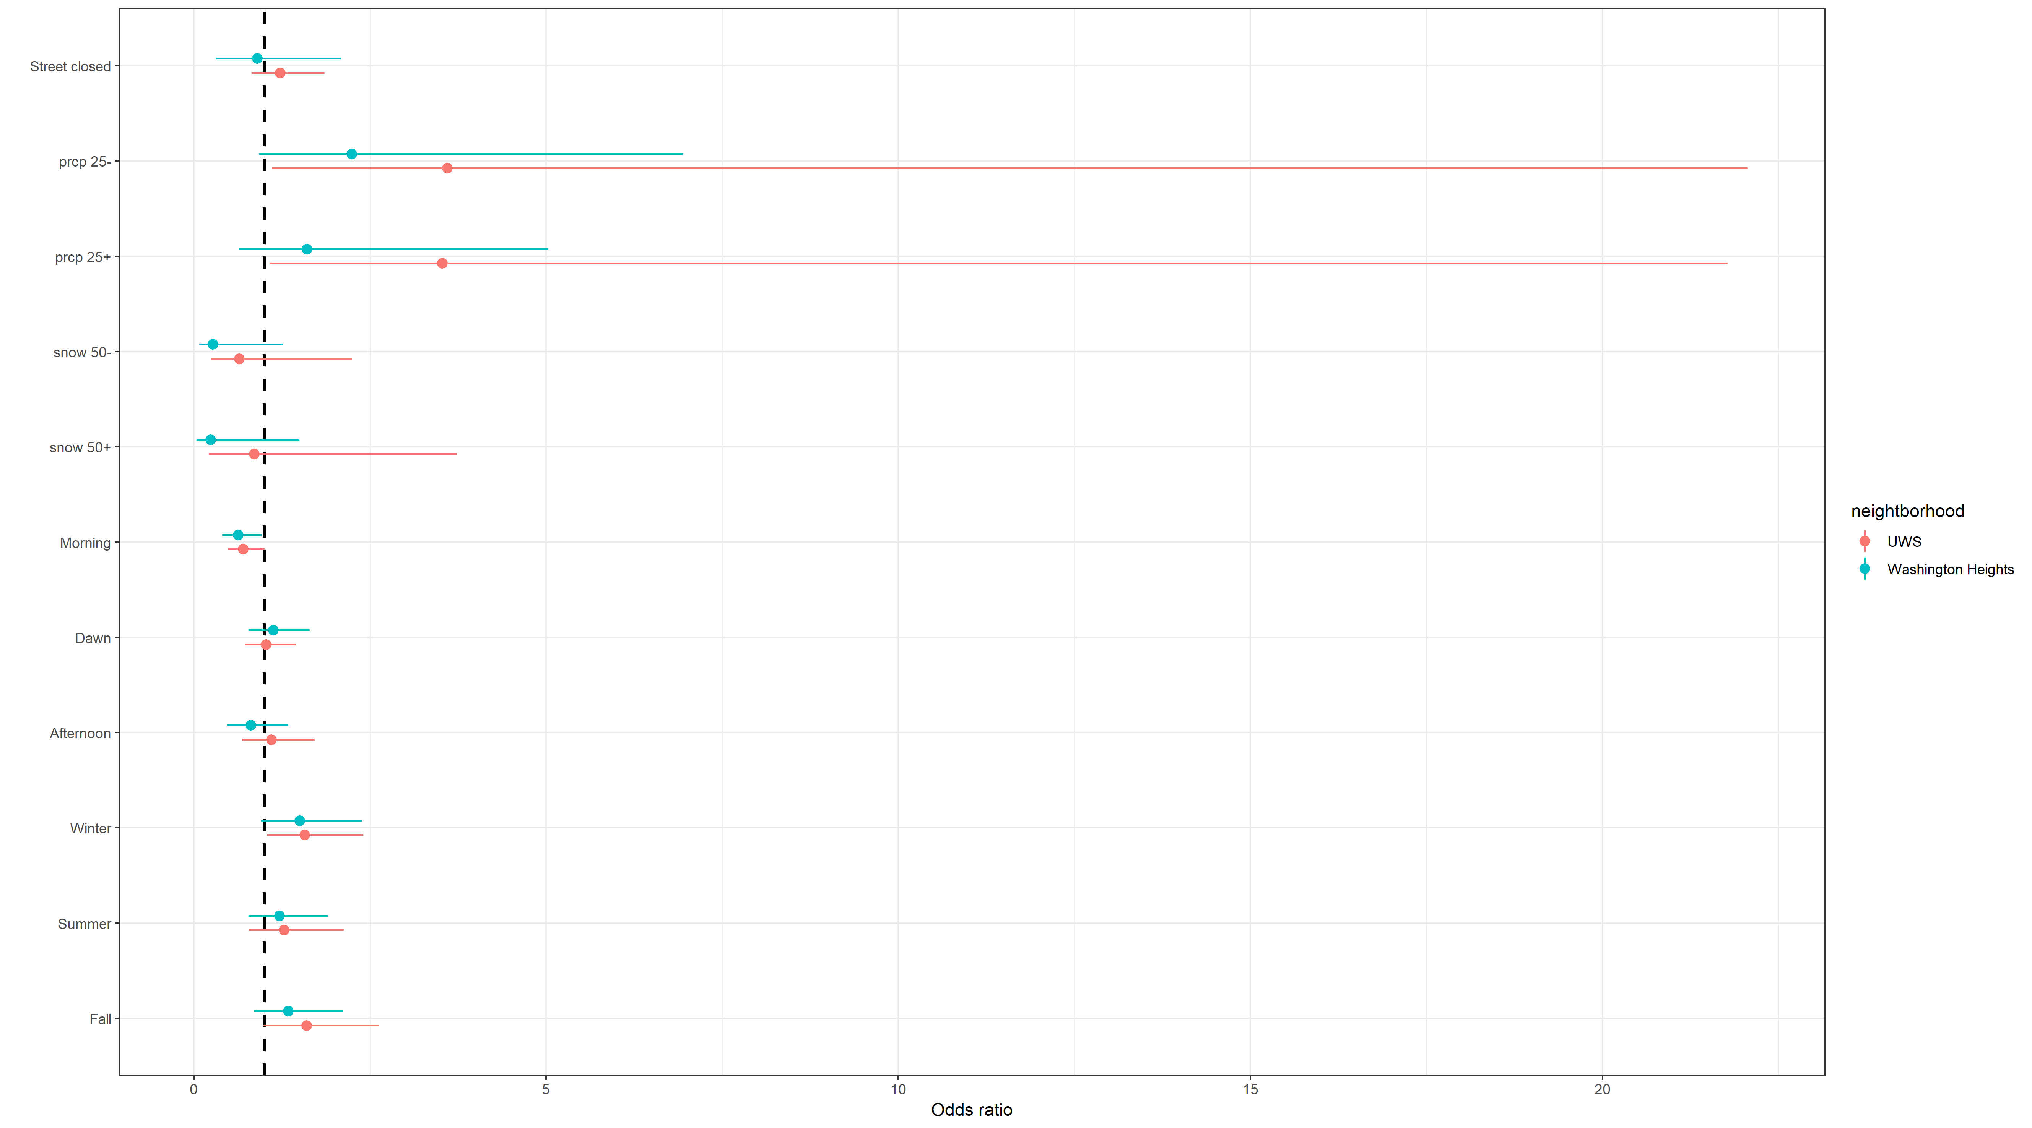
Notes:
This is the subset analysis OR visualization.

Slide 9
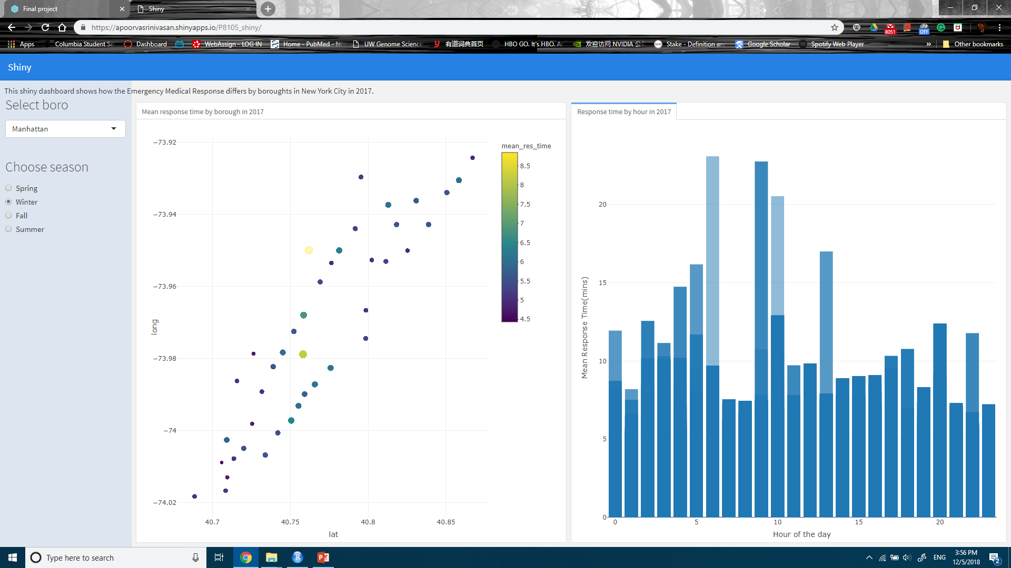

Slide 10
conclusion
Snow As expected from EDA, compared to no snow conditions, odds of over 8min response time is increased 24% by 0~50mm snow and 47% by over 50mm snow.
Season Compared to Spring, Summer does not affect odds of over 8min response time but odds is increased in Fall by 6% and in Winter by 7%.
Rain Statistically significant result was not obtained from rain variable and it matches the result of EDA.
Hour of the day In reference to night, odds of over 8min response time is increased at dawn by 26%, in the morning by 37% and in the afternoon by 35%.

Slide 11
Conclusion-subset
Street closure: not predictive to the outcome variable, the response time
Neighborhood: Washington Heights had 1.05 times the odds of response time greater than 8 minutes compared to the Upper West Side; Not statistically significant

